Slide 1
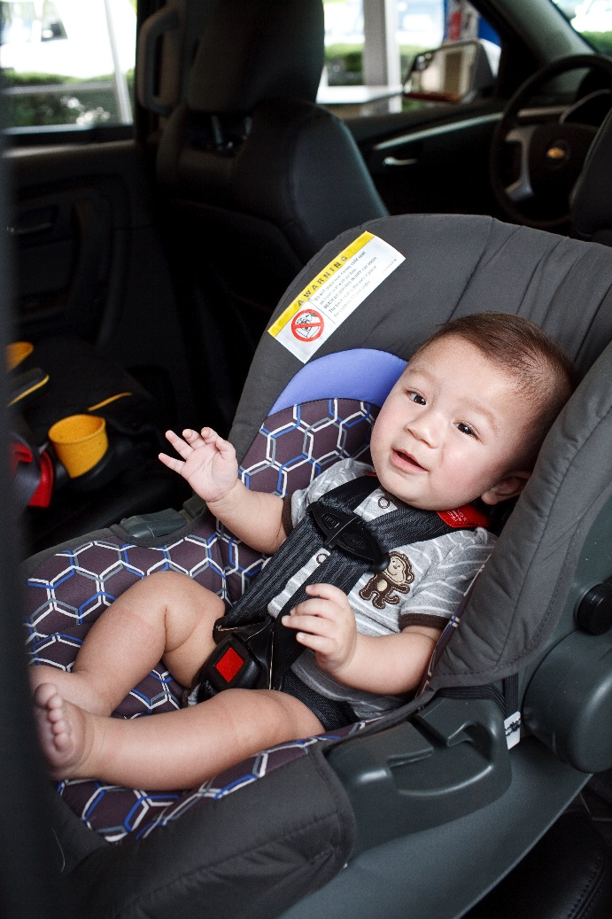
Town Meeting on CPS Laws
Presenters:
The Honorable Bella Dinh-Zarr, National Transportation Safety Board
Dr. Ben Hoffman, The American Academy of Pediatrics
Kate Bernacki, California Department of Public Health
Heidi Aakjer, Safe Kids South Carolina
Moderator: Anthony Green, Safe Kids Worldwide

Slide 2
Safe Kids Town Meeting: New Wave of Child Passenger Safety Laws
T. Bella Dinh-Zarr, PhD, MPH
Vice Chairman
November 3, 2015

Slide 3
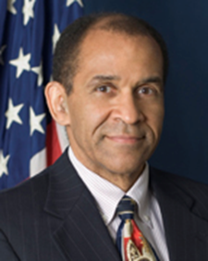
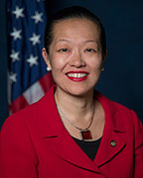
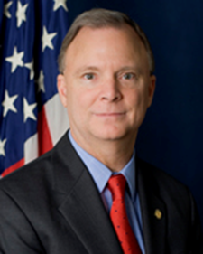
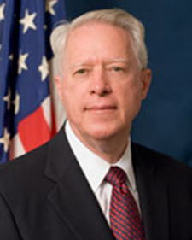
Background
Established in 1967
Reports to Congress
Made Independent in 1974
Five Board Members

Slide 4
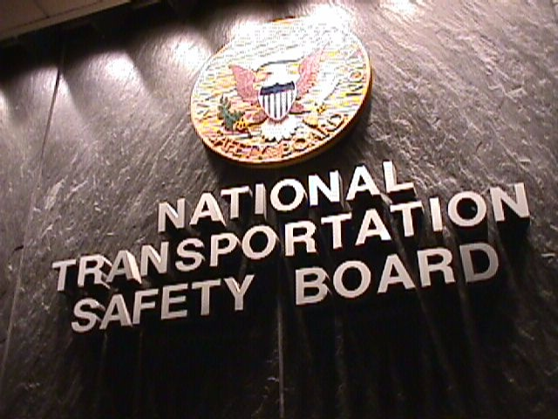
Our Mission:
Prevent Accidents
Reduce Injuries
Save Lives

Slide 5
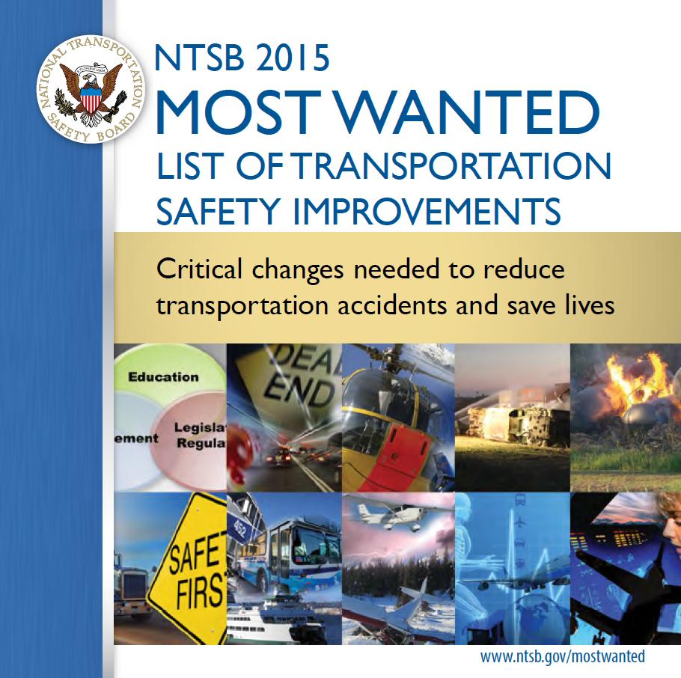
NTSB Most Wanted List
Child Occupant Protection and Primary Seat Belt Use have been focus areas of the NTSB Most Wanted List.
Recommendation to the States, territories and DC:
Ensure that children up to 8 years old are required by the State’s mandatory child restraint use law to use child restraint systems and booster seats.

Slide 6
The Impact of Motor Vehicle Crashes on Public Health

Slide 7
Child Passenger Safety Laws
DC
No Booster Seat Law
Partial Booster Seat Law
Booster Seat Law
As of November 2015

Slide 8
Advocacy Tips
Take a Comprehensive Look at your Existing Law
Know Legislative Culture in Your State
History of previous efforts
Governor’s position on issue – House/Senate leadership
Build a Strong Coalition of Supporters
Know your opposition
Know what you’re willing to compromise
Legislation must be supported with Education and Enforcement
Use the Media to help get your message out
Most importantly, If the law doesn’t change, you have not failed! Stay in it for the long run. Be persistent and patient.

Slide 9
For additional information contact:
Stephanie Shaw
stephanie.shaw@ntsb.gov
(202) 314-6014

Slide 10
How To Save A Life: Improving Child Passenger Safety Laws
Benjamin Hoffman, MD, FAAP CPST-I
American Academy of Pediatrics
Council on Injury Violence and Poison Prevention

Slide 11
Objectives
By the end of this presentation, you should be able to:
Explain why rear facing is the safest way to travel in a car
Discuss AAP Best Practice Recommendations regarding child passenger safety(CPS)
Describe how you can begin to translate this knowledge into better CPS laws

Slide 12
Motor Vehicle Crashes Kill More Kids Than Any Other Cause
2003-2013
Ages 1-15

Slide 13
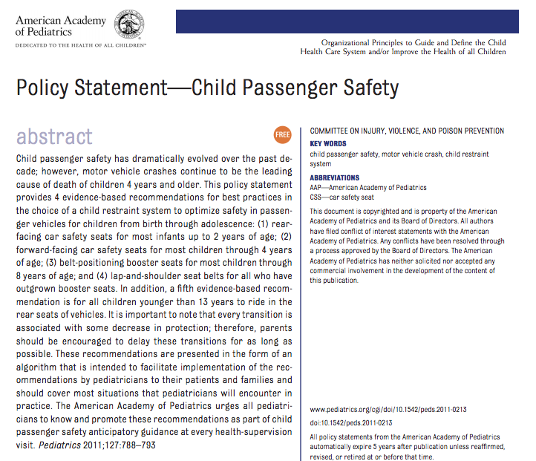

Slide 14
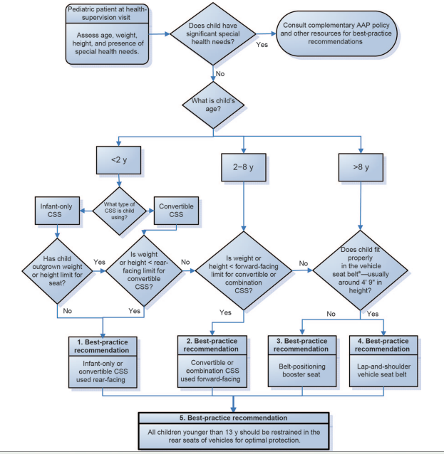
http://aappolicy.aappublications.org/cgi/content/full/pediatrics;127/4/788#F1
AAP

Slide 15
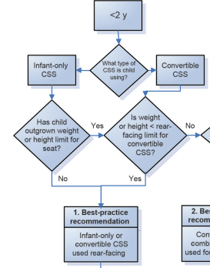
REAR FACING CAR SAFETY SEATS
“All infants and toddlers should ride in a Rear Facing Car Safety Seat until they are 2 years of age, or until they reach the highest weight or height allowed by their car safety seat’s manufacturer”

Slide 16
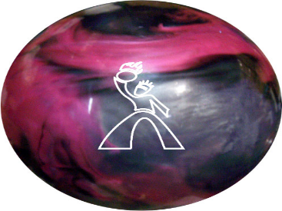
A 10 pound bowling ball dropped out of a 3rd story window
F=MA
Force= 10 lbx(32feet/sec)/(.94sec)
330 lb of intertia

Slide 17
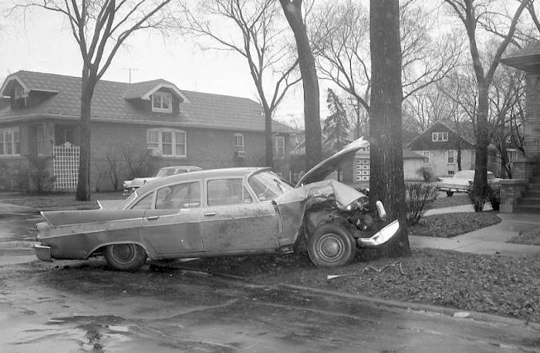
A car traveling at 30 MPH hits a tree…
10 pound child passenger
Stops in 1 second
Acceleration=45 feet/sec/sec
Inertia= 10lb (45 feet/sec/sec)=450 lb

Slide 18
More about force
Force per unit of area is key
Minimize acceleration into the impact

Slide 20
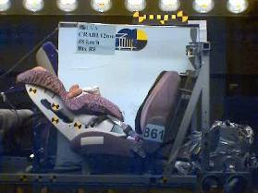
Arms and legs are safer rear facing!
NASS-CDS

Slide 22
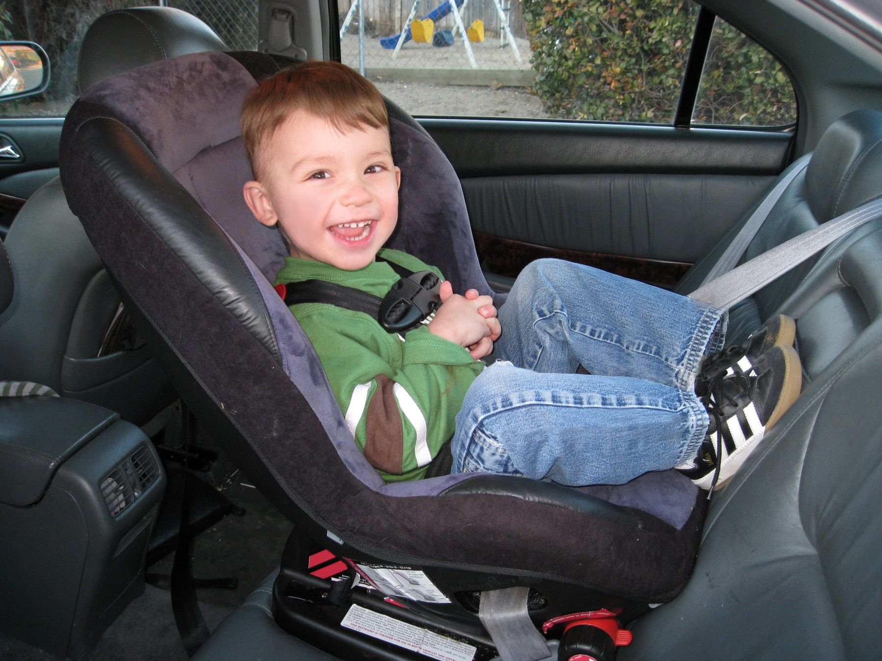
75% less likely to suffer injuries to head, neck, spinal cord.
Children age 1-2 years riding rear-facing have a 532%
decreased risk of injury
Henary et.al – 2007

Slide 23
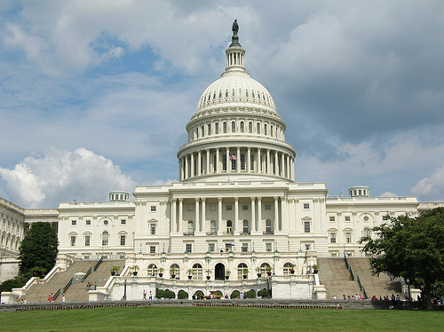
Legislation is effective!
29% decreased expenditure for injury care JTrauma 67(1), 2009
2005 NY Booster law
72% increased usage
18% decrease injury rate
Pediatrics 126(3), 2010
Up to 50% increase in restraint usage
Primary enforcement far superior

Slide 24
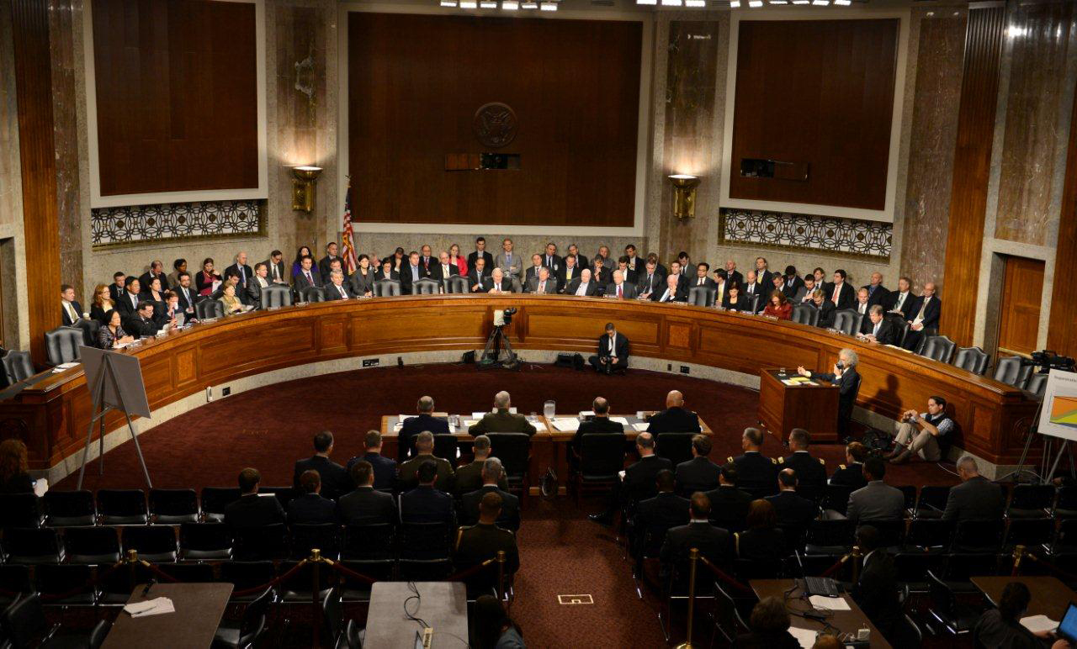
The language of legislation
Best Practice is based on multiple factors
Age
Weight
Length
Developmental/behavioral status

Slide 25
The language of legislation
Generalizable
Easily enforceable
Clear
Defensible
Passable
Lead to behavior change

Slide 26
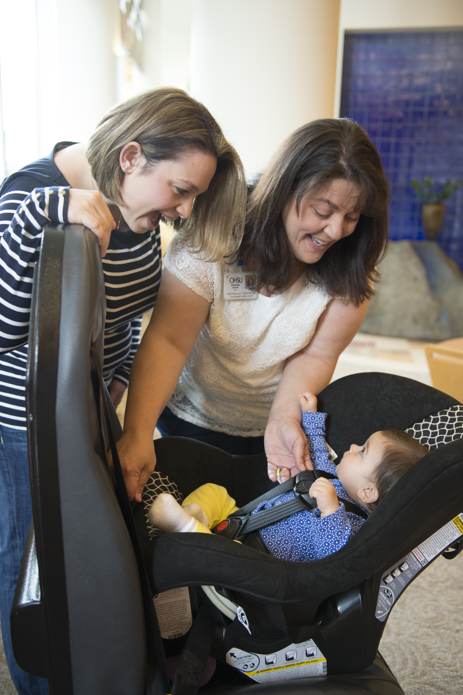
Rear Facing CPS Laws
Age based
Convertible seats easily accommodate weights beyond age 2
Length is issue with Rear facing only seats
Limits of seat
Easy to identify

Slide 27
The take home
Rear facing is always safer
532% decreased risk of injury
Lose protection with each step
Laws seldom equal best practice
Good laws meet the need of the community
Speaks the language of the legislators

Slide 28
California Child Passenger Safety Law Safe Kids Worldwide & American Academy of Pediatrics Webinar November 3, 2015 Kate Bernacki, MPH Kate.Bernacki@cdph.ca.gov Coordinator, Vehicle Occupant Safety Program, California Department of Public Health Funding for this program was provided by a grant from the California Office of Traffic Safety, through the National Highway Traffic Safety Administration

Slide 29
California Child Passenger Safety Laws
California CPS Laws include:
0-8 years: all children under 8 years old in the rear seat in a child restraint or booster seat.
8-16 years: all children under 16 years old in a child restraint, booster or vehicle seat belt.
Fines: $475 (can attend traffic school to remove the point on their driving record, and can attend a CPS violator class to reduce or waive the fine).
A portion of the fines go to the local public health department specifically for CPS education and services.
Upon departure from medical clinic/facility, all parents receive CPS law information as well as where they can have their car seats inspected.
Statewide Directory of CPS services – “Who’s Got Car Seats?”
Kaitlyn’s Law (leaving unattended children in vehicles). Same fines and penalties as CPS law.
Assembly Bill (AB) 53 (Garcia, Chaptered 292, Statutes of 2015) effective January 1, 2017 requires:
A parent, legal guardian, or the driver of a motor vehicle to properly secure a child who is under 2 years of age in an appropriate rear-facing child passenger restraint system, unless the child weighs 40 or more pounds or is 40 or more inches in height.

Slide 30
CA CPS Parent Brochure (2012)

Slide 31
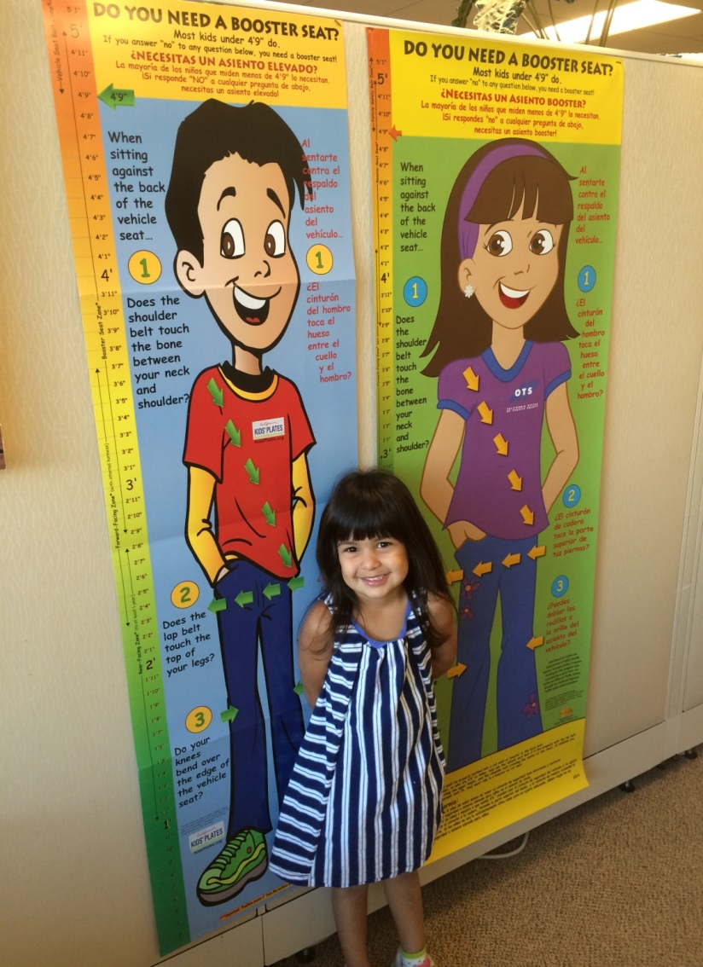
POTENTIAL NEXT STEPS Partners – Pulling together expert team to develop uniform message, offer funding, decide on educational materials, timing/roll out. Costs/Money – Translation, printing, media buys, distribution. Types of materials – PSA, radio, social media, websites, brochures, posters, Roll Call video. Distribution – Local Safe Kids Coalitions/Chapters, local Public Health Departments, state and local law enforcement, hospitals, pediatricians, fire departments, daycares and schools.
California Child Passenger
Safety Education
California Department of Public Health
Safe and Active Communities Branch Vehicle Occupant Safety Program (VOSP)

Slide 32
Assessing Advocacy:
Influencing Prevention Policy through Effective Communication with Legislators and Advocates
Heidi Aakjer, MPA
Safe Kids South Carolina Manager
Whitney Tucker, MPH
Policy and Research Associate
Notes:
Children’s Trust is a 501(c)(3) organization with the mission of strengthening and supporting public and private prevention efforts that keep South Carolina’s children safe. We focus our efforts on preventing child abuse, neglect, and unintentional injuries. Children’s Trust is an umbrella organization, much like a United Way or community foundation, and we are home to KIDS COUNT South Carolina, Safe Kids South Carolina, Prevent Child Abuse South Carolina and other programs that deliver on our mission. In addition to funding programs, measuring results and ensuring delivery on critical prevention work in South Carolina, we also advocate for positive public policies that promote child well-being.

Slide 33
The Need for Advocacy
3 Main Injury Prevention Areas
Motor Vehicles Suffocation Drowning
Assets of Safe Kids advocates:
Community involvement
Appreciation for prevention work
Grassroots engagement ability
Legislation is needed to adequately address child injury issues on a grand scale
Notes:
Safe Kids coalition injury prevention advocates are directly involved in the communities affected by the preventable deaths and serious injuries of children
Their neighbors, church members, and sports club teammates are the prime audience for their daily work
Because Safe Kids advocates are directly involved in the communities affected by the preventable deaths and serious injuries of children, they understand and appreciate just how important preventive work is
That recognition, in conjunction with their community relationships, makes them perfect for grassroots engagement work
In light of this, Children’s Trust partnered with local Safe Kids coalitions to focus injury prevention efforts in three specific areas: motor vehicle accidents, suffocation and drowning
These three areas were top priority as they are the leading causes of childhood injury fatalities in South Carolina according to the Centers for Disease Control and the SC Department of Health and Environmental Control
Local efforts to inform parents of these hazards and encourage proper safety precautions only reach a small subset of the population at one time, and legislation is needed to adequately address child injury issues and see a significant reduction in child deaths in the state

Slide 34
Recommendations
Build Relationships.
Increase time spent lobbying, engaging with legislators
Capitalize on Social Networks.
Can be gleaned for volunteers, partnership opportunities
Collaborate.
Increase media attention
Identify local connections to legislators
Grow organizational capacity
Train.
Legislators depend on well-informed nonprofit lobbyists
Focus on motor vehicle and motor boat safety
Notes:
While the Safe Kids coalitions are powerful in numbers (including more than 600 trained child passenger safety technicians), they have not been organized around advocacy efforts
Few coalition members will contact their legislators regarding a particular issue and even fewer engage their elected officials at a local level
Successfully increasing advocacy capacity will require coalition members to devote more time to building relationships with policymakers
The social networks of Safe Kids advocates are largely under-utilized
Searching these avenues for volunteers and opportunities to increase awareness and partnership would allow for more time to be spent engaging legislators
Collaboration with other nonprofits would garner greater media attention for Safe Kids coalitions and would likely increase the impact of advocacy efforts on legislators and members of legislative staff
Additionally, Safe Kids coalition members will require more effective training on injury prevention issues to become more informed advocates in these areas
Legislators and legislative staff consider lobbyists for nonprofit organizations an important source of information, and effective communication of accurate data is essential to maintaining that trust.

Slide 35
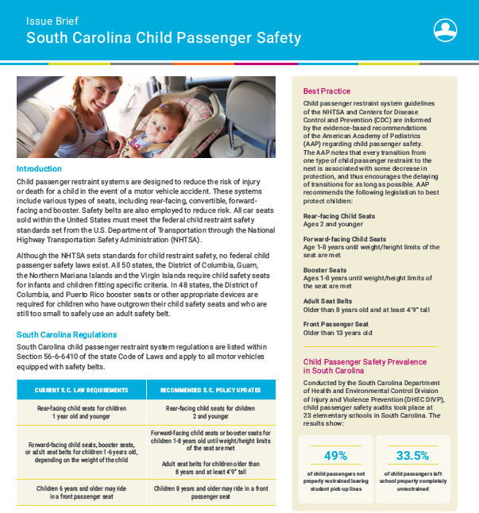
CPS Brief

Slide 36
Advocacy in Action
SC Safe Kids Advocacy Day April 28, 2015
SC Child Passenger Safety Summit
September 18, 2015

Slide 37
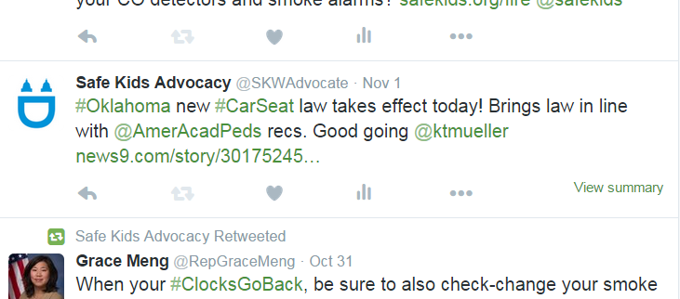
KEY STRATEGIC POINTS
Research, research, research
Laws Influence Parents
Laws Increase Public Awareness
We’re Here to Help

Slide 38
Heidi Aakjer, MPA
Safe Kids South Carolina Manager
Children’s Trust of South Carolina
haakjer@scchildren.org │ 803-744-4020
Whitney Tucker, MPH
Policy and Research Associate
Children’s Trust of South Carolina
wtucker@scchildren.org │ 803-744-4049
Special thanks to the Society for Community Research and Action (SCRA), Division 27 of the American Psychological Association (APA), for the funding to complete this project. The findings and conclusions presented do not necessarily reflect the opinions of SCRA or APA.

Slide 39
QUESTIONS?
Remember to Take the Survey at the End of the Webinar

Slide 40
Contact Information
Safe Kids Worldwide Contacts
Presenters:
Stephanie Shaw, NTSB
stephanie.shaw@ntsb.gov
Ben Hoffman, AAP
hoffmanb@ohsu.edu
Kate Bernacki, California Deptartment of Public Health kate.Bernacki@cdph.ca.gov
Heidi Aakjer, Safe Kids South Carolina
haakjer@scchildren.org
Anthony Green, Policy Director agreen@safekids.org
Reuben Overmark, Policy Associate rovermark@safekids.org

